Slide 1
SwiftServe Ordering Platform - Team X1
Team X1
Hrudith, Jhanghir, Sudeep, Rahul S., Rahul G., Nicholas

Slide 2
AGENDA

Slide 3
Agenda
Member Introductions
Problem Statement
Tech Stack
Accessibility Features
Usability Reports
Project Management
Additional Thoughts

Slide 4
MEMBER INTRODUCTIONS

Slide 5
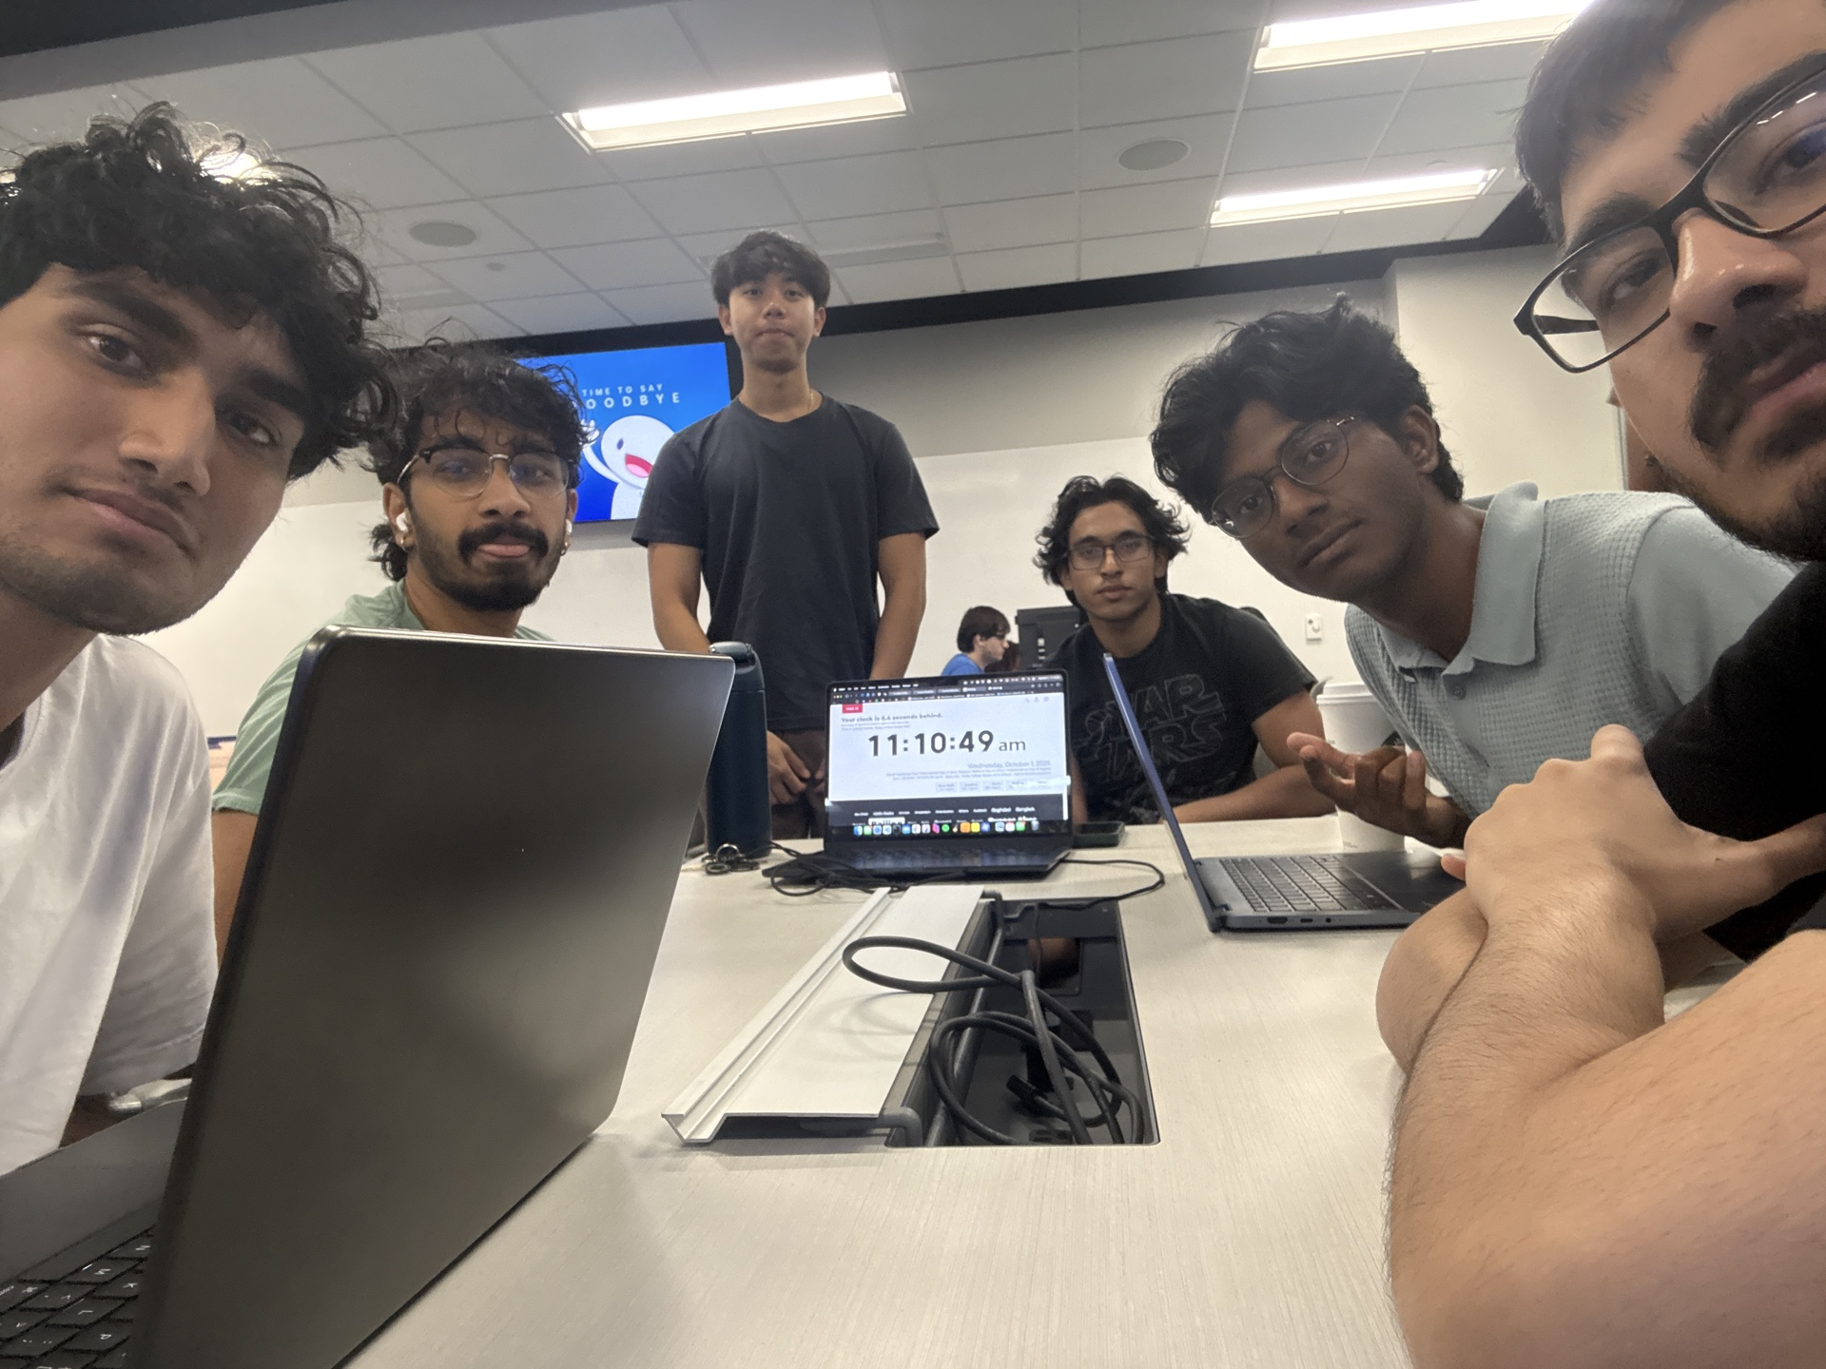
Team X1
Full Stack: Hrudith
Backend: Jhanghir
Backend: Sudeep
Frontend: Rahul S.
Database & API : Rahul G.
UI/UX & Testing: Nicholas
<Full Team Photo>

Slide 6

Full Stack: Hrudith
Dedicated Role Responsibilities
Full stack architecture design
Frontend/backend system integration
End-to-end feature implementation
Shared Role Responsibilities
Code reviews and collaboration
Bug fixes and troubleshooting

Slide 7

Backend: Jhanghir
Dedicated Role Responsibilities
PostgreSQL database development
Database schema and migrations
Authentication and authorization
Shared Role Responsibilities
Backend Database and API Testing
Bug fixes and troubleshooting

Slide 8

Backend: Sudeep
Dedicated Role Responsibilities
API endpoint development
Order and payment systems
Inventory management logic
Shared Role Responsibilities
Code reviews and collaboration
Database management and testing

Slide 9

Frontend: Rahul S.
Dedicated Role Responsibilities
React component development
UI implementation with Tailwind
State management with Zustand
Shared Role Responsibilities
Backend Code reviews
UI development

Slide 10
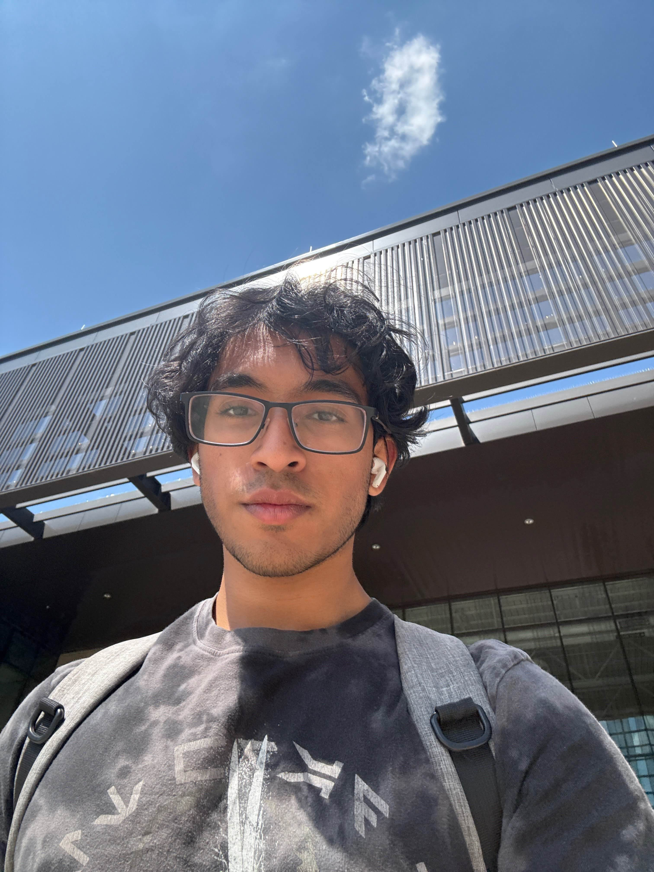
Database & API: Rahul G.
Dedicated Role Responsibilities
PostgreSQL database administration
SQL optimization and queries
Data migration scripts
Shared Role Responsibilities
Frontend code reviews
Bug fixes and troubleshooting

Slide 11
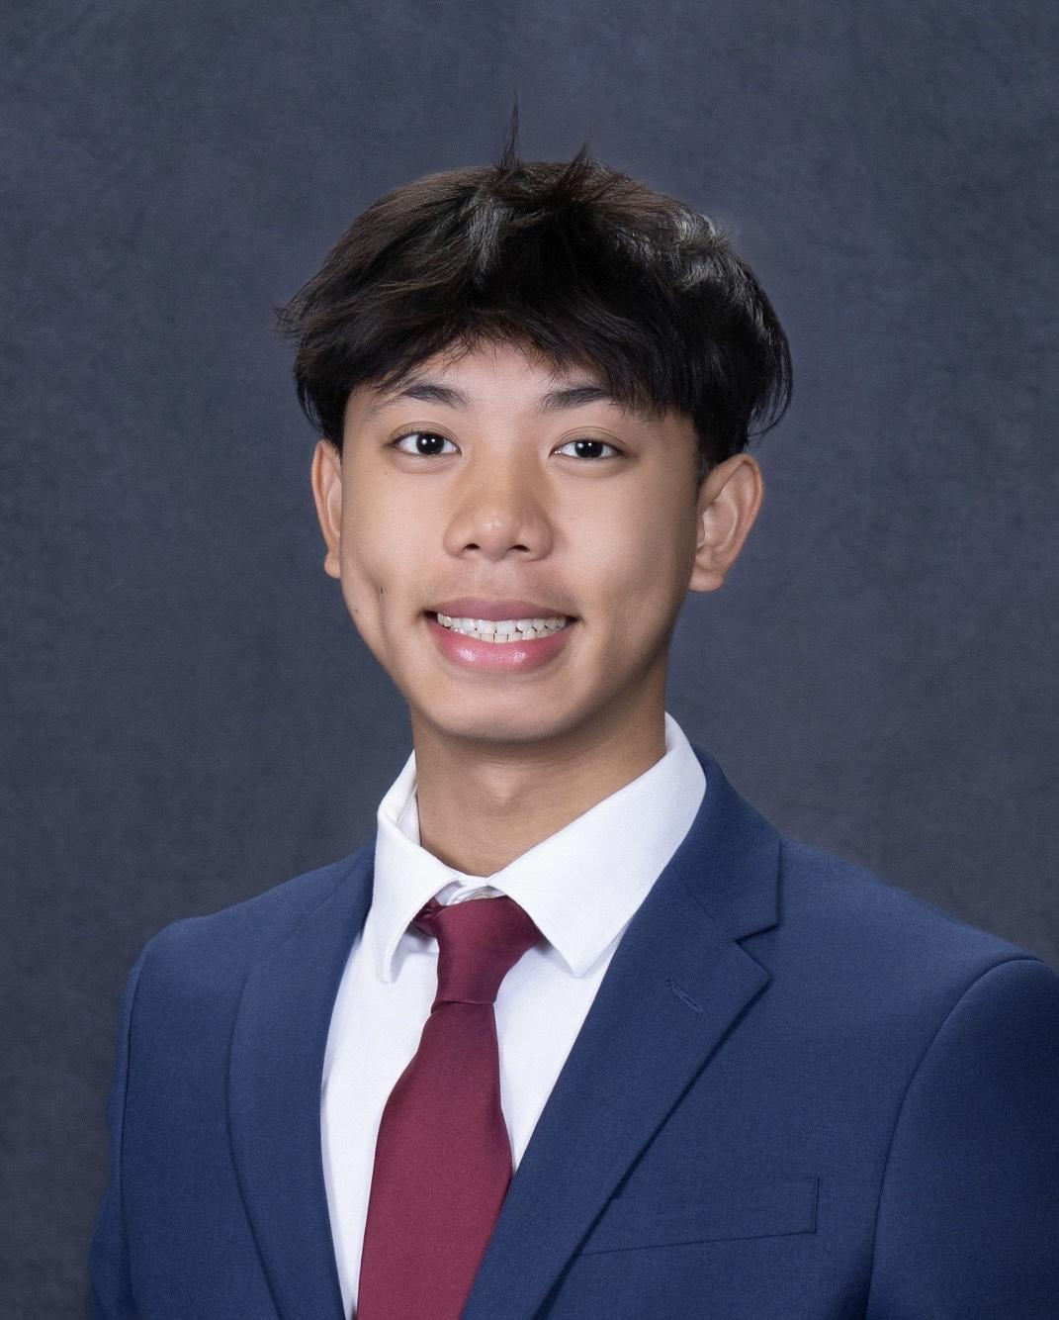
UI/UX & Testing: Nicholas
Dedicated Role Responsibilities
User interface design
Usability and accessibility testing
User feedback analysis
Shared Role Responsibilities
Database management
Bug fixes and troubleshooting

Slide 12
PROBLEM STATEMENT

Slide 13

Product Idea
Comprehensive SaaS solution for Sharetea franchise operations
Modern point-of-sale system replacing outdated legacy systems
Multi-role support: Manager, Cashier, Barista, Customer
Real-time order processing and kitchen display system
Inventory management with automatic alerts
Analytics and reporting dashboard

Slide 14

Project Details
Full-stack web application with role-based dashboards
Google OAuth 2.0 authentication system
PostgreSQL database with normalized schema
RESTful API architecture
Real-time updates for kitchen operations
Weather-based menu recommendations using AI
User
Google Login
OAuth Token
Backend Verification
Dashboard Access

Slide 15

State-of-the-Art
Cloud-based deployment (Supabase + Vercel)
WCAG 2.1 AA accessibility compliance
Multilingual support (Google Translate API)
AI-powered features for enhanced customer experience
Responsive design for multiple device types

Slide 16
TECH STACK

Slide 17
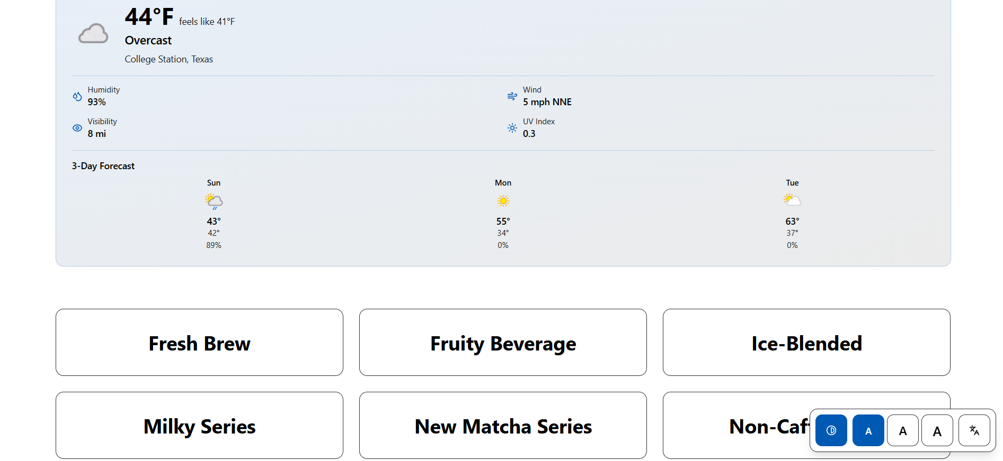
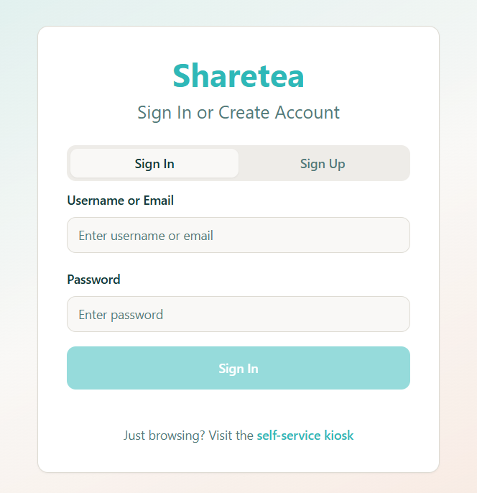
Frontend Development
React 18 with Vite build system
React Router 6 for navigation
Zustand for state management
Tailwind CSS for styling
Vitest + React Testing Library

Slide 18
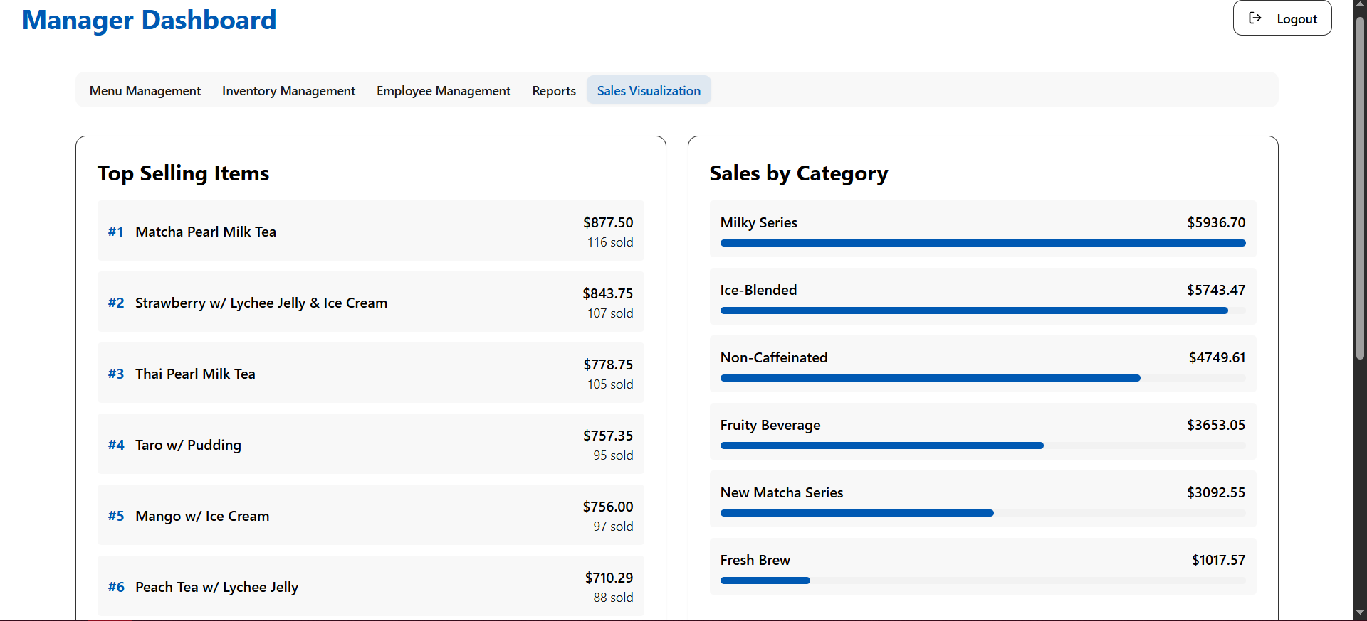
Backend Development
Node.js with Express framework
PostgreSQL 14+ database
Passport.js for authentication
JWT token-based authorization
Bcrypt for password hashing
Postman for API testing

Slide 19
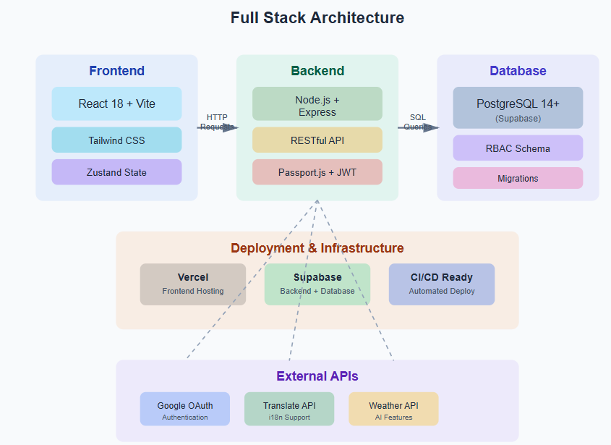
Full Stack Development
Monorepo architecture with npm workspaces
RESTful API design principles
Role-based access control (RBAC)
CORS-enabled cross-origin requests
Environment-based configuration
CI/CD ready deployment structure

Slide 20
ACCESSIBILITY FEATURES

Slide 21

1st Persona: Maria
Community health worker
Her mobile phone is her first computer
Uses computer translations
Needs clearly written information
Spanish/English bilingual

Slide 22



Accessibility Features for Maria
English/Spanish language toggle available
Google Translate widget embedded
Mobile-responsive design for phones
Clear labels in both languages
Simple, consistent navigation patterns
Semantic HTML structure throughout
Form fields with bilingual support

Slide 23

2nd Persona: Vishnu
Engineer, working on medical technology
World citizen through technology
Low vision due to glaucoma
Uses screen magnifiers
Contrast adjustment

Slide 24



Accessibility Features for Vishnu
Adjustable font size controls (A-/A/A+)
High contrast mode toggle available
ARIA labels for screen readers
Full keyboard navigation support
Clear focus indicators on elements
Real-time font size preview display
Semantic time elements with attributes

Slide 25

3rd Persona: Carol
Grandmother learning to use technology from grandkids
Macular degeneration causing tremors and limits reading capabilities
Has learned to enlarge text in browser

Slide 26
Accessibility Features for Carol
Large text up to 150%
High contrast theme reduces strain
Large touch targets for buttons
Skip navigation links for content
Clear visual hierarchy with spacing
Settings persist across browser sessions
Extra padding on interactive elements

Slide 27
USABILITY REPORTS

Slide 28
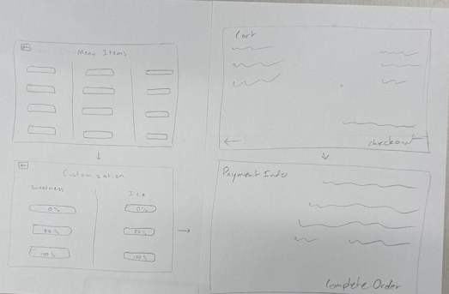
Lo-fi Prototyping
Initial sketches for user flows
Paper prototypes for menu navigation
Basic POS interaction wireframes
Customer kiosk layout concepts
Manager dashboard structure planning
Early accessibility feature considerations
Rapid iteration without coding

Slide 29
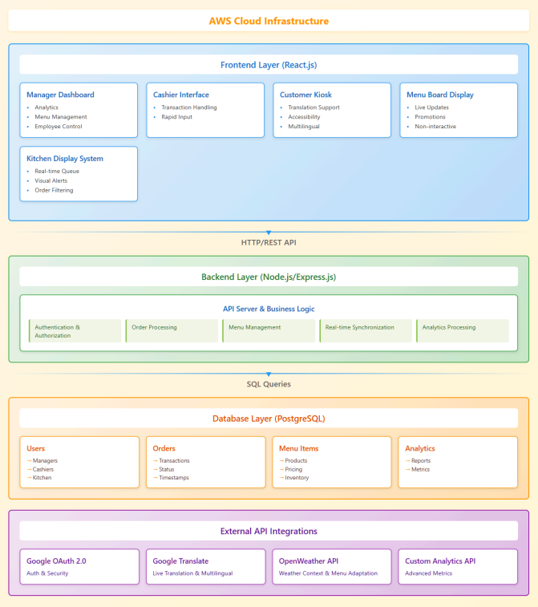
Hi-fi Wireframes
Figma designs for all interfaces
Complete component library created
Detailed POS cashier screen
Customer kiosk ordering flow
Manager dashboard with analytics
Accessibility controls panel design
Responsive layouts for mobile

Slide 30
User Study Feedback
Conducted accessibility-focused user testing
Three personas tested all flows
High-contrast mode validated positively
Language toggle worked effectively
Font size controls well-received
Navigation found clear and intuitive
Minor improvements identified and implemented

Slide 31
User Study – Key Questions & Responses
Question | Participant Response (Summary) | Insight / Action Taken
How easy was it to read the text with the enlarge feature turned on? | “Much better, I could read everything without glasses.” | Font-size control validated, kept as-is
Were the buttons and menu items easy to tap/select? | “Still a bit small and close together, I mis-tapped a few times.” | Increased button padding + minimum touch target to 48px
Did the high-contrast mode help in different lighting? | “Yes, especially the dark version - very comfortable.” | Made tweaks for, otherwise kept as-is
How intuitive was switching languages? | “Very easy, the icons made it obvious.” | Language toggle kept, added tooltip labels across the site
Overall, would you feel comfortable using this system daily? | “Yes, with the bigger buttons and contrast, definitely.” | Positive validation of accessibility direction

Slide 32
PROJECT MANAGEMENT

Slide 33
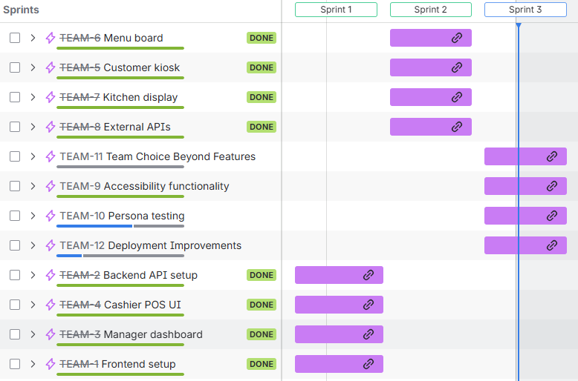
Product Backlog Summary
Total: 192 story points created
Completed: 121 points
Sprint 1: 58 points
Sprint 2: 63 points
Remaining: 71 points
Status: On track

Slide 34
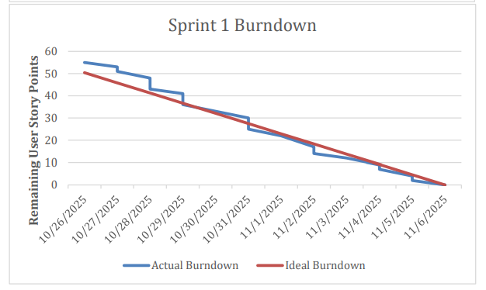
Sprint 1 Status
Duration: Oct 26 - Nov 16
Points completed: 58 total
Velocity: 29 points/week
Tasks: 23 items completed
Zero tasks deferred
Foundation successfully built

Slide 35
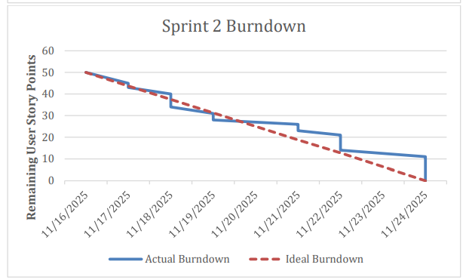
Sprint 2 Outlook
Duration: Nov 16 - Nov 24
Points completed: 63 total
Velocity: 31.5 points/week
Improvement: 8.6% over Sprint 1
All APIs integrated
UI features delivered

Slide 36
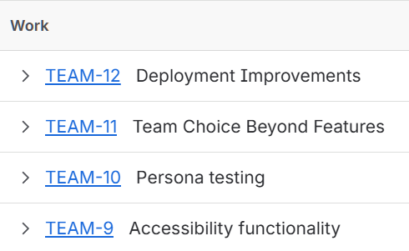
Sprint 3 Outlook
Duration: Nov 24 - Dec 7
Target: 65-70 story points
Focus: Testing and deployment
Regression testing all features
Final UI polish
Production deployment ready

Slide 37
Overall Project Outlook
Week 1
Testing & Quality: Unit tests, Integration tests, E2E tests Core Features: Focus indicators, Resizable text, Persona flows (Maria, Vishnu, Carol) Accessibility: Accessibility tests, Usability features, Color contrast, Screen reader Infrastructure: Keyboard nav, GitHub Actions, AWS EC2, PostgreSQL Target: ~45-50 story points
Week 2
Deployment: Domain + SSL, Backup strategy, Monitoring Final Integration: API + SaaS integration Regression Testing: Test all Sprint 1 & 2 features, cross-browser, mobile UI Polish: Final adjustments, performance, bug fixes, documentation Demo Preparation: Demo script, practice, slides Target: ~20-25 story points
Week 3
Pre-demo checklist (all features deployed, data populated, etc.) 7-step demo flow outline Success criteria (192 points complete, WCAG compliance, etc.)
Progress: 61% complete (121/192 points)
Velocity: Steadily increasing
Critical features: On schedule
Accessibility: Close to completion
Deployment: Sprint 3 target
Demo date: December 7
Week 1
Week 2
Demo Day

Slide 38
ADDITIONAL THOUGHTS

Slide 39
Questions
Best practices for production OAuth callback URLs?
Recommendations for database migration strategies?
Suggestions for load testing approach?
Guidance on API rate limiting implementation?
Feedback on our accessibility approach?

Slide 40
Concerns
Managing environment variables across platforms
Database connection security in cloud environment
OAuth flow testing in production
Performance under expected load

